Slide 1
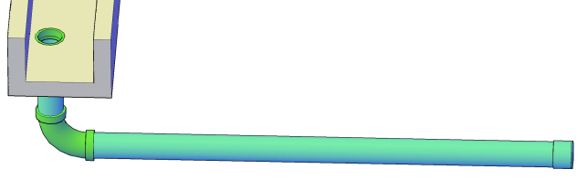
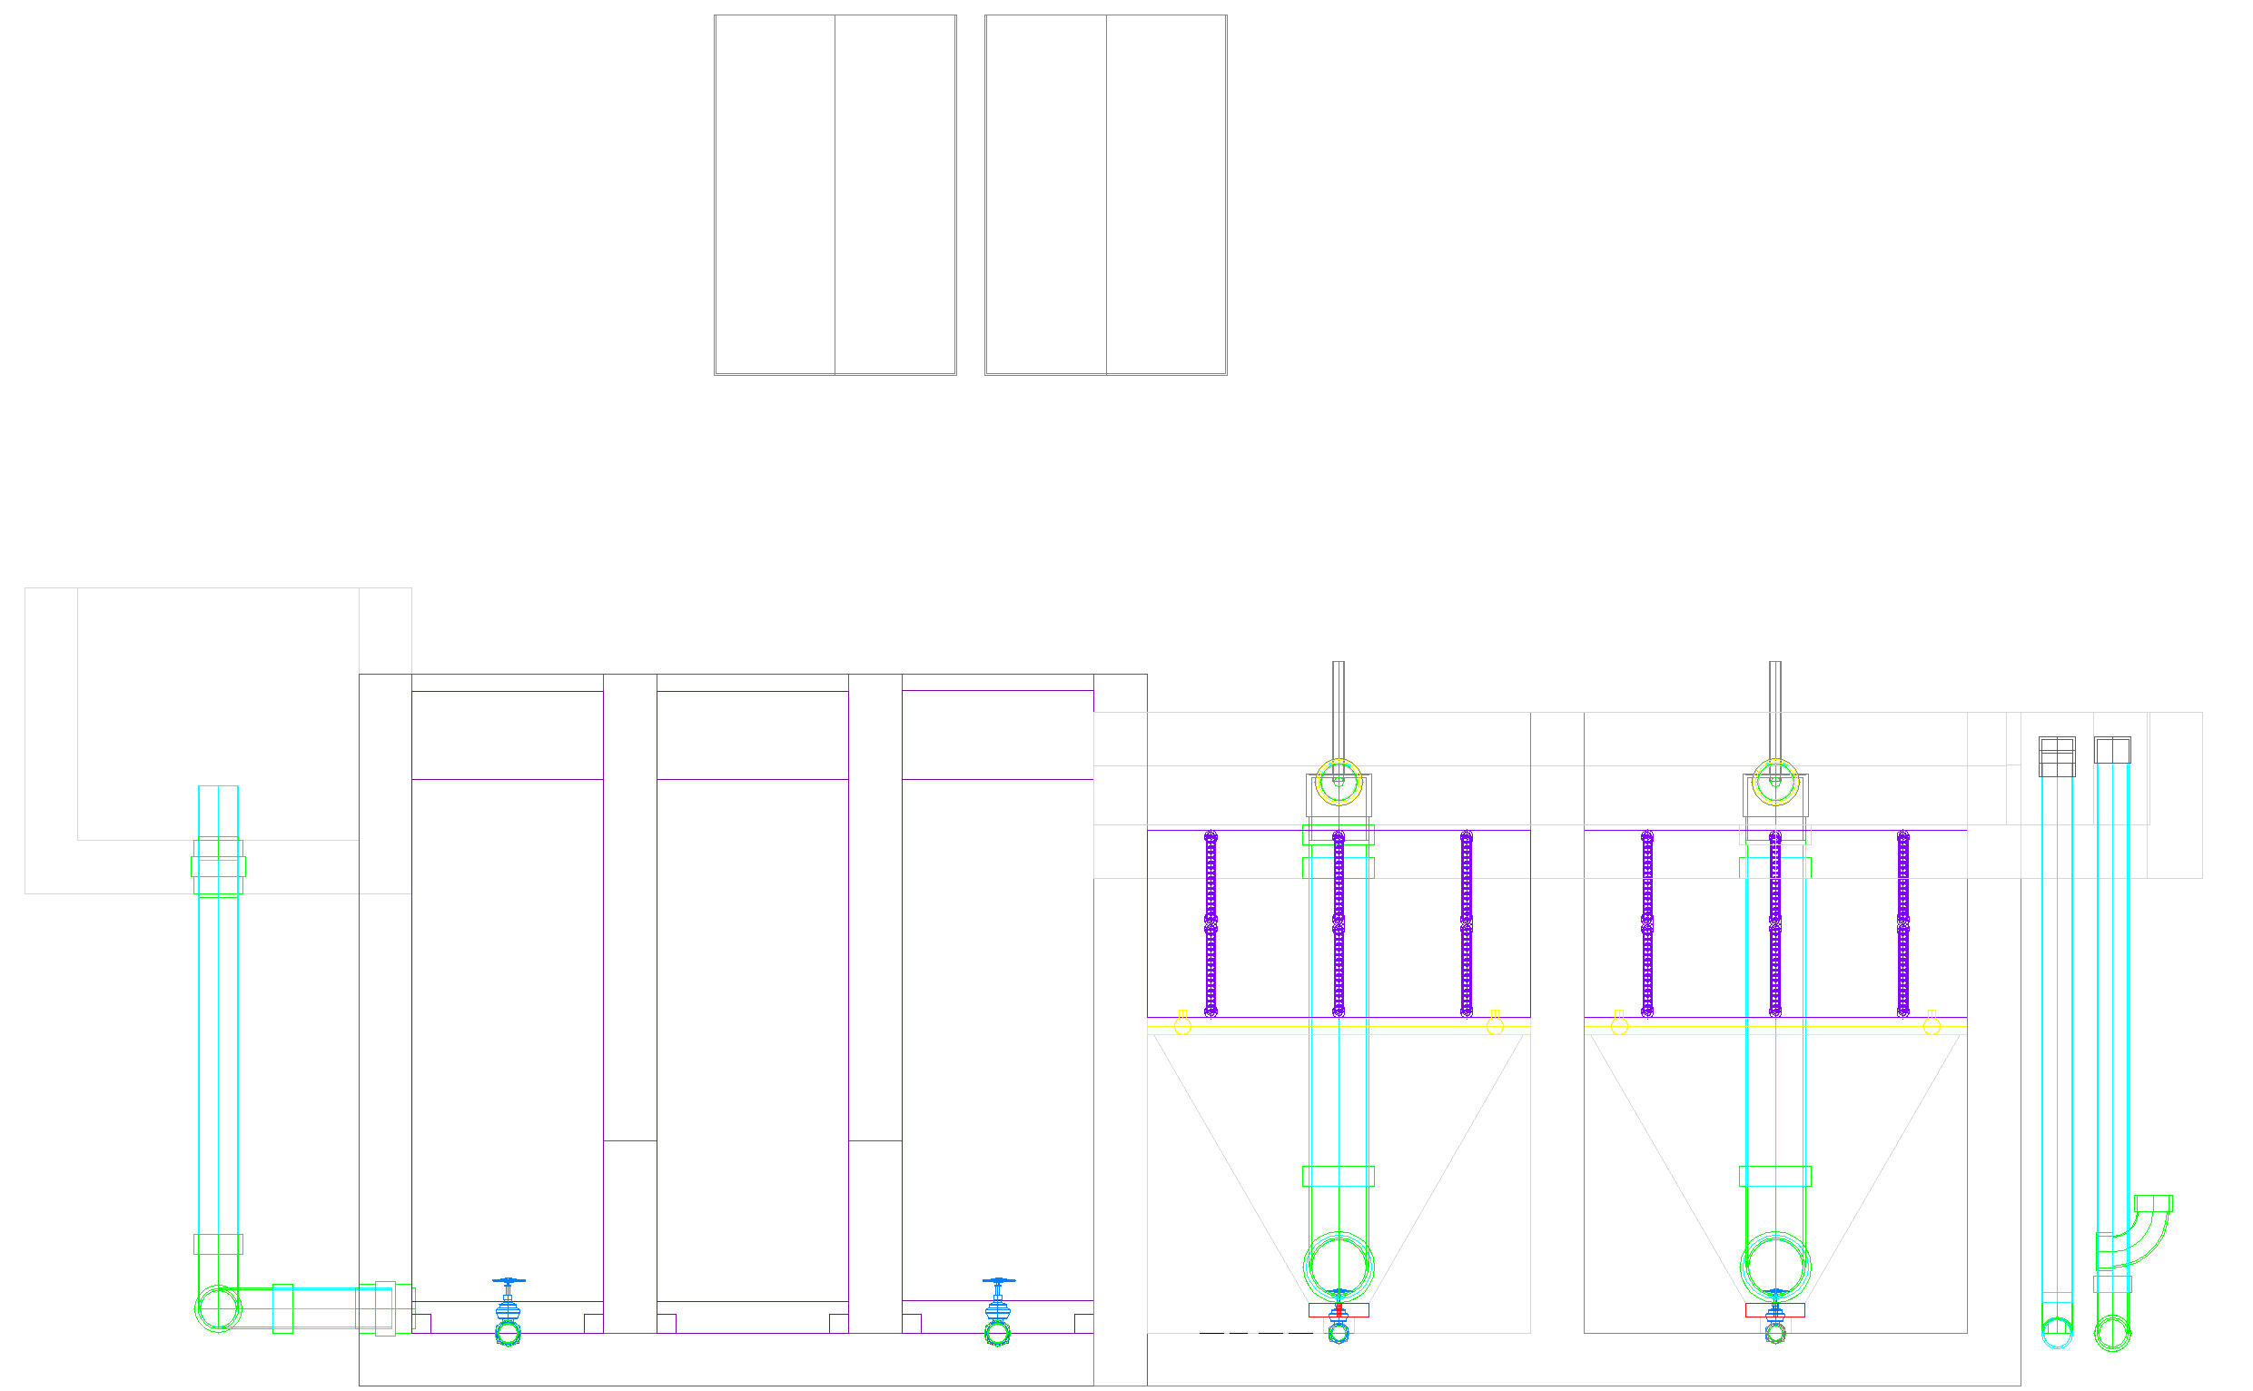
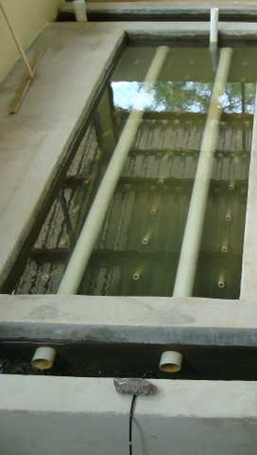
Inlet and Outlet Manifolds and Plant Hydraulics
Using direct fluid feedback rather than indirect computer feedback to control flows
In which Changes in Kinetic Energy BECOMES SIGNIFICANT
(Thanks to A.A. Milne)

Slide 2

Nomenclature: a start
Symbol | Description | Sub
Q | Flow | P | Port
A | Area | M | Manifold
 | Piezometric head | D | Diffuser
h_{L} | Total Head Loss | e | expansion
HGL | Hydraulic Grade Line | 1 | Short path
EGL | Energy Grade Line | n | Long path
C_{p} | Pressure Coefficient (includes shear and expansion effects)
Π_{vc} | Area of the vena contracta divided by the orifice area = 0.62
D | Diameter
Π | Dimensionless ratio
n | Number of ports
p | Pressure at the centroid of a control surface
 | Average velocity across a control surface

Slide 3
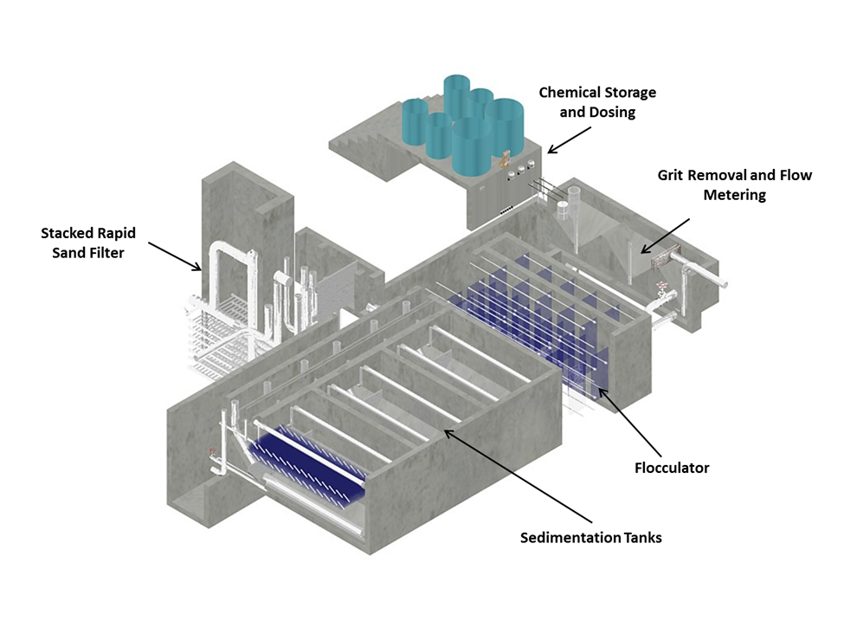
Places we’d like Equal Flow Distribution
Sedimentation
between sed tank bays
between diffusers into sed tank
between plate settlers
Filtration
between filters
Between filter layers
Notes:
We currently use flow restrictions in the effluent launder to divide the flow between the sedimentation tanks.

Slide 4
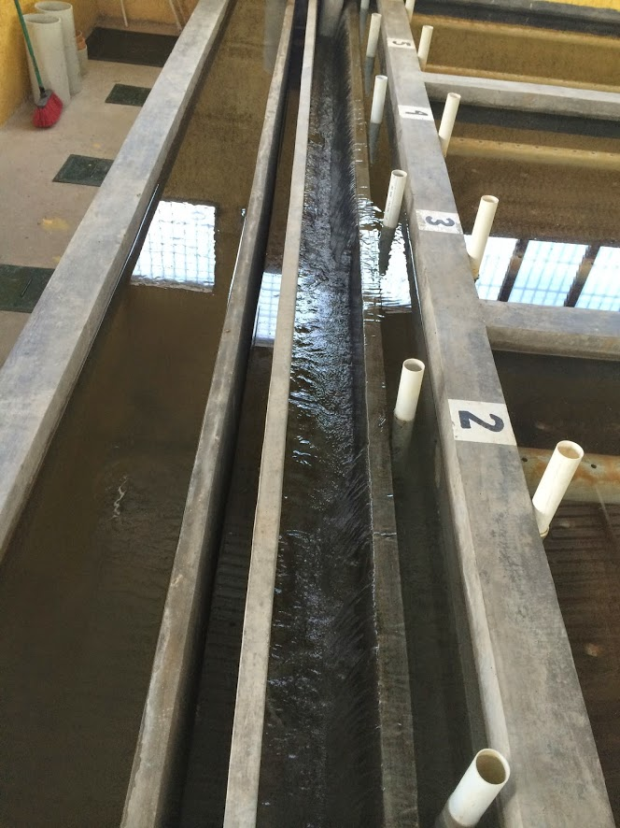
Sed Flow distribution
Pipe stubs to block sed tank inlet manifolds
Inlet channel
Flocculated water to waste
Sensor access to floc hopper
Settled water outlet channel
Weir that controls water level in sed tank (and flocculator)
Which sed tank will have the highest flow?
Notes:
#6 will have the highest flow rate if inlet channel has a constant cross sectional area.

Slide 5
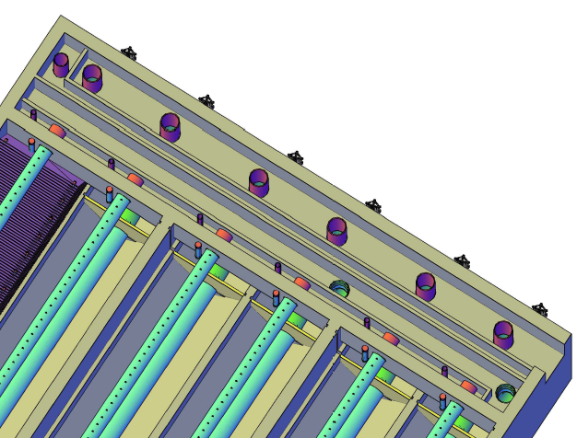
Sedimentation tank controls
Drain for flocculated water
Weir that maintains the water level in the flocculator when flocculating to waste
Wall between inlet and outlet channels
Exit weir that maintains the water level in the sedimentation tank (and flocculator)
Exit to the filters
Entrance from the flocculator

Slide 6




How can we make water split equally between several paths in a manifold?
Draw a manifold with ports that you think would give unequal flow. Orifices diameters are uniform.
Draw a manifold with ports that you think would give equal flow
What do you think is important? (pressure, elevation, kinetic energy)
1
2
n-1
n
cs₁
cs_{n}
Inlet manifold
Notes:
Vertical manifold or manifold at a slant?
Draw slanted pipe in a lake and discuss what causes water to flow in a pipe
Change in pressure or elevation or energy

Slide 7
4 strategies
Make the paths identical (often not possible)
Add custom head loss to each path (complicated!)
Increase identical head loss in all paths to make differences insignificant
Sed inlet manifold diffuser pipes have high exit velocities
Sed effluent manifold uses orifice head loss
Reduce head loss and pressure recovery that cause differences in piezometric head
Use large diameter pipes for manifolds
Rule of thumb - exit and entrance velocities must be greater than manifold velocity!

Slide 8


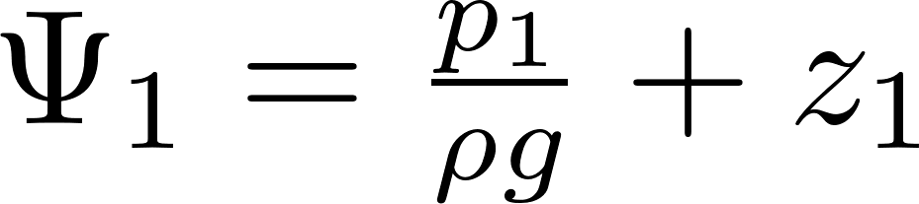
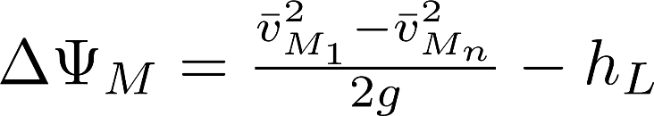
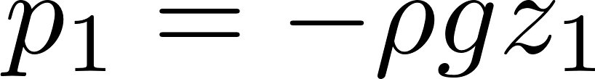
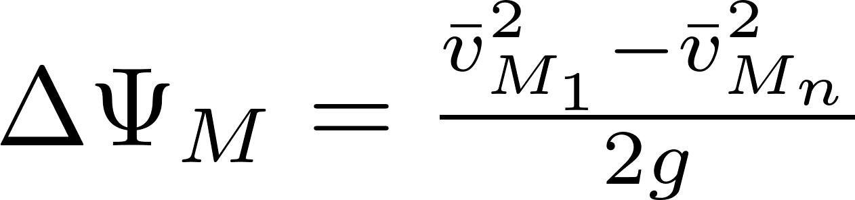
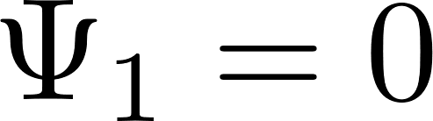
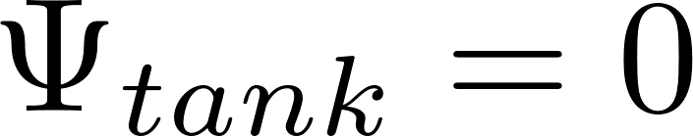
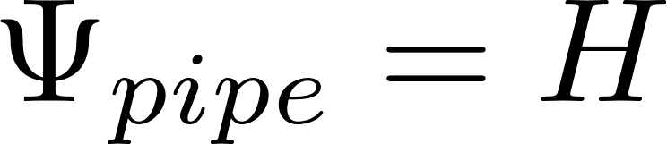
Piezometric head
H
Z=0
1
1
Piezometric head in an outlet manifold increases in direction of flow!
What is the piezometric head
in the tank?
In the pipe (no flow)?
In the manifold (with flow)
n
Notes:
Fluid goes from high piezometric head to low piezometric head (for ports exiting normal to the flow)
Draw piezometers on

Slide 9
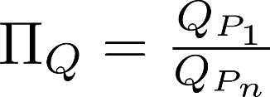
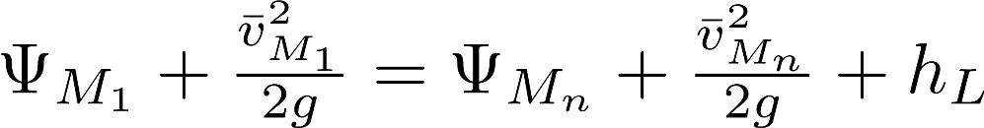
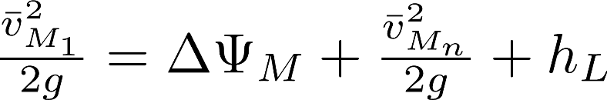
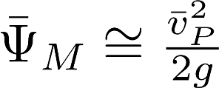
Flow distribution between ports in an inlet manifold
Which port is going to get the most flow?
There is a very gradual flow expansion!
The water is being stopped by pressure on the end cap
Where is the manifold pressure highest?
1
2
n-1
n
cs₁
cs_{n}
Inlet manifold
Notes:
Draw manifold in lake picture
Define Pi.Q= Qp1/Qpn
Define H average (=vjet^2/2g) and ΔH (vpipe^2/2g) showing manometers
Note that shape of inlet (pitot tube) matters
ΔH proportional to 1/A^2 (from orifice eq)
How do you get Pi.Q = 1?
H average > ΔH
Ajet<Apipe

Slide 10
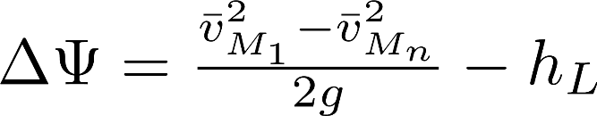
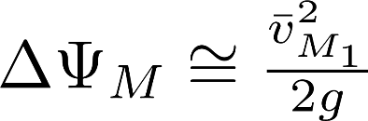
Change in piezometric head from port 1 to port n (inlet manifold)
For short (fL/d <<1), straight (K=0) inlet manifolds the change in piezometric head is equal to the initial velocity head
The same for outlet manifolds except piezometric head decreases in the direction of flow
1
2
n-1
n
cs₁
cs_{n}
Inlet manifold

Slide 11
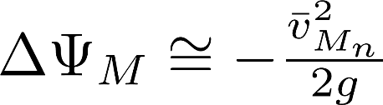
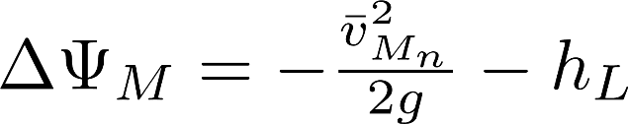
Change in piezometric head from port 1 to port n (outlet manifold)
For short (fL/d <<1), straight (K=0) outlet manifolds the change in piezometric head is equal to the negative final velocity head
n
n-1
2
1
cs_{n}
cs₁
Inlet manifold

Slide 12
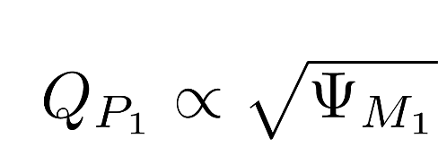

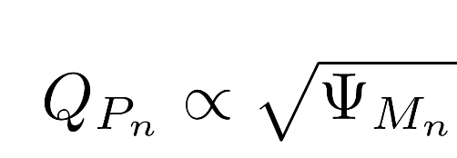

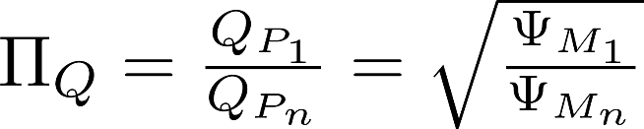

Flow Division Analysis for Inlet Manifold (with orifice outlets)
Total difference between paths 1 and n
To simplify analysis we assume middle port gets the average flow (this isn’t quite right because the velocity is squared) and hence has the average piezometric head.
Port one has mean piezometric head – ½ delta piezometric head
Flow ratio is less than one
Last port has higher flow
We can achieve uniform flow by increasing
Notes:
Change in piezometric head is the same for both routes!
The loss coefficient is different and that means that the flows will be different too.
This is missing the effect of pressure recovery
Need a method to specify

Slide 13
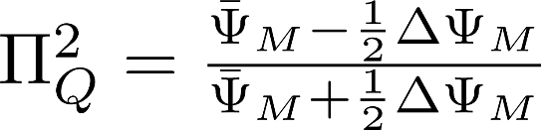

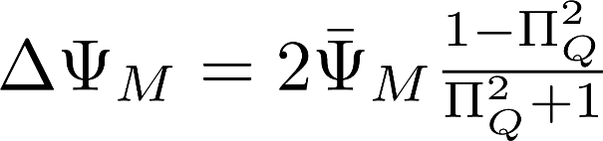
Solve for the maximum permissible change in piezometric head
Solve for
This is change in piezometric head in the manifold as a function of port flow uniformity and average piezometric head across the ports.

Slide 14
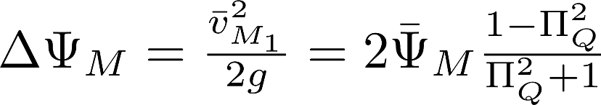
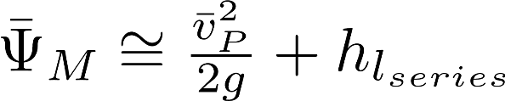
Relationship between port contracted velocity and manifold velocity
Port flow uniformity equation
Piezometric head in the manifold (energy equation)
If head loss in the manifold is small, then we have
Pressure recovery
differences in port flow
causes
is the contracted port velocity
The average manifold piezometric head sets the average port velocity

Slide 15
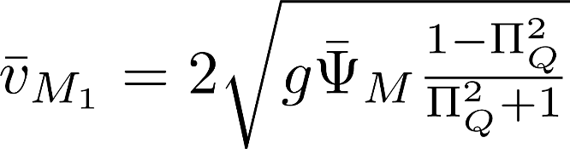
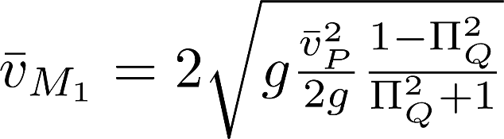
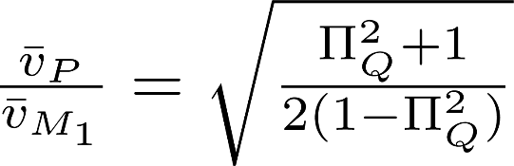
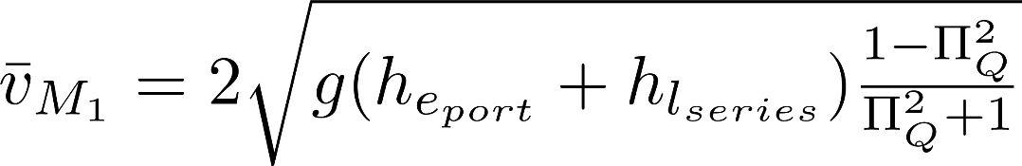
Manifold velocity
Pressure recovery =
No head loss in series
With helpful head loss in series

Slide 16

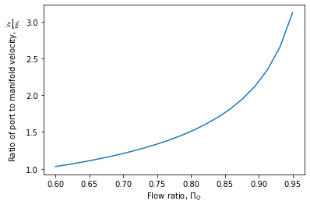
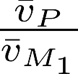
Plot port velocity over manifold velocity as a function of
Total port area must be smaller than pipe area to get reasonable flow distribution

Slide 17
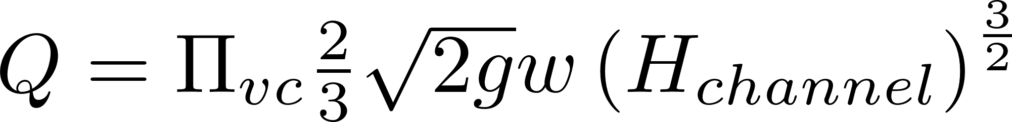
Filter Inlet Channel Design
Channel provides water to all of the filters
Water exits the channel by flowing over the top of sharp crested weirs to enter the filter inlet boxes
Small changes in water elevation in the channel will cause significant changes in flow rate to the filters

Slide 18
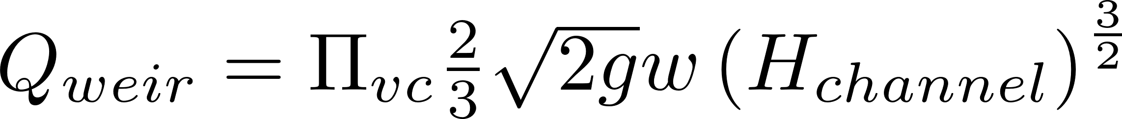
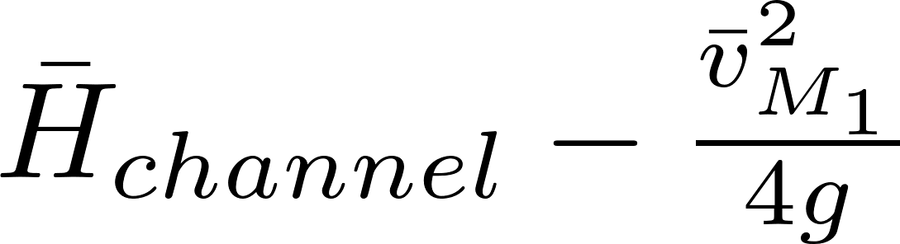
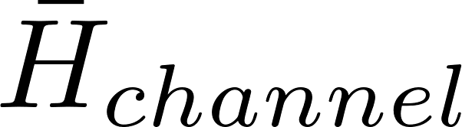
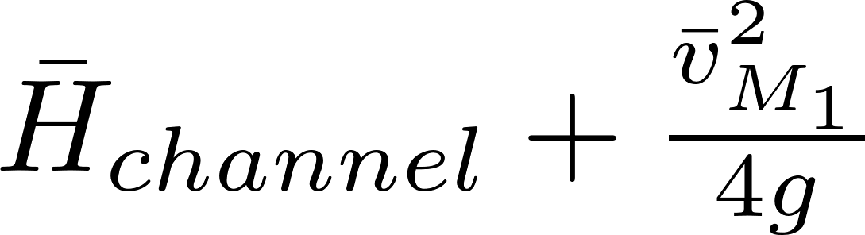

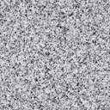
Manifold Channel
Looking toward channel from filter inlet boxes
Filter 1
Filter n/2
Filter n
Water in channel
Water in filter inlet

Slide 19
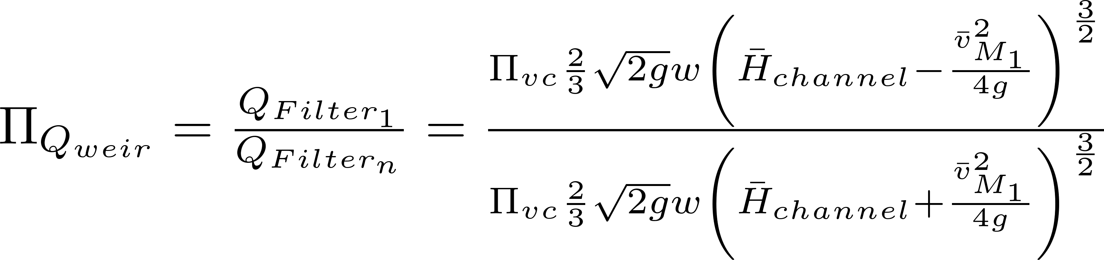
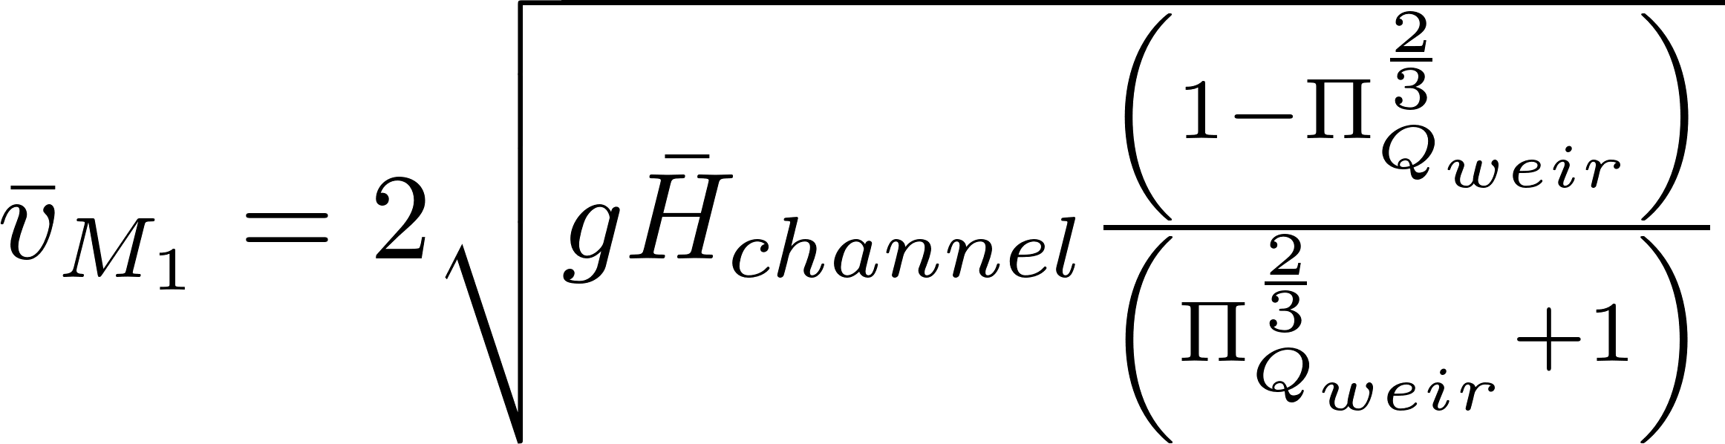
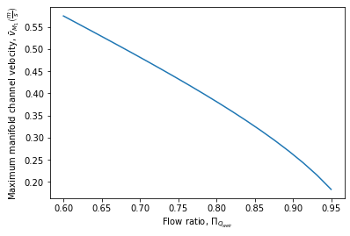
Open channel side exit weir flow distribution
Define the flow ratio
Solve for the maximum manifold velocity
Alternative solution is slope the bottom of the channel (but this doesn’t solve the problem when some filters are off line)
Assumes 5 cm over the weirs

Slide 20

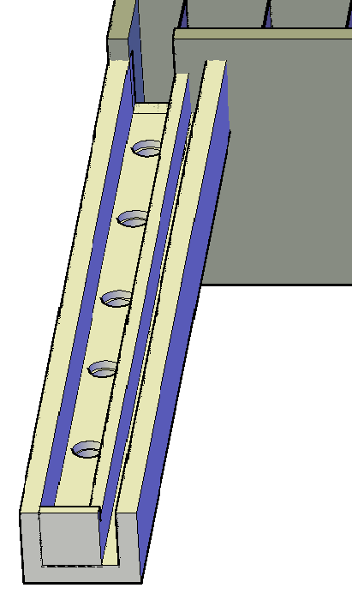




Sed Tank as a Circuit: Flow Distribution Challenge
Piezometric head change from flow acceleration and head loss
Battery creates 5 to 10 cm of potential energy to drive the flow
Launder exit losses
Settled water outlet channel
Launder orifice loss
Floc blanket and plate settlers
Inlet channel
Diffuser exit loss
Inlet manifold
Effluent manifold (Launder)
Piezometric head change from
Flow deceleration and head loss
Flow distribution thru parallel paths is a major hydraulic design challenge
Notes:
We will cover this in manifold hydraulics if we have time. Which resistance is good and improves flow distribution? Which resistance makes flow distribution poor?
Improve by increasing losses in diffusers and in orifices

Slide 21

Manifold flow distribution Including major head loss
We will derive equations in terms of Hydraulic Grade Line (HGL) because piezometric head controls the port flow
Port flow
based on _______ equation
Piezometric head change (ΔΨ) across port
flow expansion
Piezometric head change (ΔΨ) between ports
Darcy-Weisbach and Swamee-Jain
orifice
In manifold

Slide 22
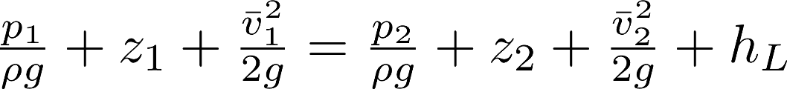
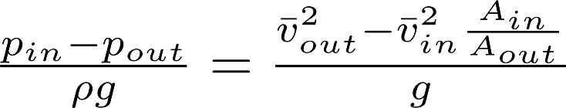

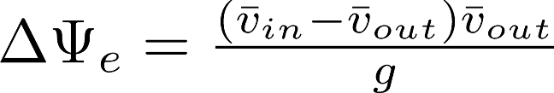
Inlet Manifold
Change in piezometric head from expansion pressure recovery across one port (flow expansion)
Pressure recovery
EGL
HGL
1
2
n-1
n
Major head loss
Notes:
Which port has the highest flow

Slide 23
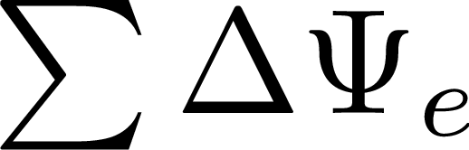
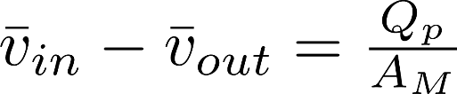

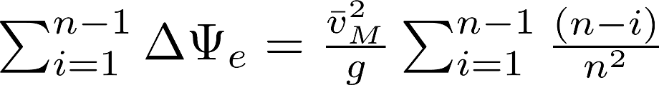



What is as a function of n? (sum of the change in piezometric head from expansions)
Now sum across all ports
Approaches for large n
_______________ is recovered for very gradual expansion.
All kinetic energy

Slide 24
Outlet Manifold (Launder)
Flow contractions, thus no significant minor loss!
EGL
HGL
All of the changes at the ports sum to
1
2
n-1
n

Slide 25






Head Loss in a Manifold (same for inlet or outlet)
Define manifold length as
Head loss in a manifold is __ of the head loss with constant Q.
1/3

Slide 26





Change in Piezometric Head in an Outlet Manifold
Total change in piezometric head
Note: We have factored out the friction factor knowing that and thus f is not constant

Slide 27


Change in Piezometric Head in an Inlet Manifold
This equation gives the difference in piezometric head between the first port and the last port. Since the two terms have opposite signs the maximum difference could be at an intermediate port. We need to determine if one of these terms dominates to see if the maximum difference really is between the first and last ports.

Slide 28
Conclusions
Manifolds are complicated (and important)!
Manifold head loss is 1/3 the head loss in a pipe
Difference in piezometric head drives the flow through the ports
Manifold kinetic energy is converted to pressure increase
Following slides develop equations for detailed design of manifolds (reference for your future careers!)

Slide 29
Solution Path
The length of the manifold will be determined by the plant geometry
The spacing of the ports will be set by other constraints
We need to determine the diameter of the manifold and the diameter of the ports

Slide 30


Launder: Traditional Design Guidelines
Recommended port velocity is 0.46 to 0.76 m/s (Water Treatment Plant Design 4th edition page 7.28)
The corresponding head loss is 3 to 8 cm through the orifices
How do you design the diameter of the launder? (coming up…)
Would this work if head loss through the manifold were an additional 10 cm? _____
NO!
Notes:
Water Treatment Plant Design 4th edition page 7.28

Slide 31
Design Constraints
For sed tank Inlet Manifold the port velocities and the manifold diameter are set by the _____________________________________
For the outlet manifold that takes clear water from the top of the sed tank bays the goal will be to keep head loss low and greater than construction errors in level of weir (we aim for about 5 cm)
Diffuser jet velocities

Slide 32



Design for Outlet Launder
Given target head loss between sed tank and clear water channel (5 cm for AguaClara)
Minor loss equation
0
Solve the minor loss equation for the manifold diameter

Slide 33
Outlet Launder Diameter: Iterative solution for D_{M}
The iterative solution will converge quickly because f varies slowly with Re.

Slide 34
Example Code for Iteration
First guess at solution
Error ← 1
Set error to be large to ensure that loop executes once
MaxError ← _____
While Error > MaxError
Improved guess
Dimensionless error
Return y₁

Slide 35

Launder Diameter (Approximate Solution)
Here we are omitting the major (wall shear) head loss contribution
In this equation the head loss is the total head loss for both the orifices and the pipe flow

Slide 36
Example: Launder
What is the minimum launder diameter for a plant flow rate of 50 L/s divided between 8 bays if we use 5 cm of head loss? For an approximate solution you can omit the effect of the major losses. Use a value of 0.8 for the minimum flow ratio between the last and first orifice

Slide 37
Example: Launder
What is the effect of the shear force?
How can we estimate the length of the launder? We will assume that the sed bay has a width of 1 m.
What is the length of the sedimentation tank?
V↑ = 1 mm/s

Slide 38
Example: Launder
n is the number of orifices (ports). If the port spacing is 10 cm how many are there?
62
For large n
1.36

Slide 39
More exact solution…
What diameter launder do you recommend?
6 inches

Slide 40
Why is the launder diameter so large?
(50L/s /9) launder of 6 inches
The head loss in the launder is small and it would be tempting to use a smaller pipe
Why is such a large pipe necessary?______________
Why do we even need a launder pipe? ___________________________________________ ___________
What is the max velocity above the plate settlers given a 1 m wide tank, 25 cm of water above the plates, a single launder? __________
Equal orifice flow
For uniform flow distribution between (and within) plate settlers
2 mm/s
Notes:
I take the last question as a real question. Do we actually need launders? Would it be better to lay a perforated cloth on top of the plate settlers to help get uniform flow distribution between plates and then use a simple orifice in the channel wall to create 5 cm of head loss to force flow between bays to be equal?

Slide 41
What is the horizontal velocity above the plate settlers without a launder?
This velocity is very large compared with the head loss through the plate settlers (about 1 μm) and thus elimination of the launder would result in preferential flow through the plate settlers closest to the exit

Slide 42
Approach to Find Port Diameter
Calculate the head loss in the manifold
Subtract 50% of that head loss from the target head loss (5 cm) to estimate the port head loss
Calculate the port diameter directly using the orifice equation

Slide 43
What about Inlet Manifold Design?
Total head loss is not a constraint (it will be VERY small)
Energy dissipation rate at the inlet of the manifold determines the manifold diameter
Energy dissipation rate at the inlet to the diffuser pipes will set the diffuser diameter
Available pipe sizes for inlet manifold and for the diffusers is a constraint

Slide 44
Schulz and Okun guidelines: Note these cause floc breakup!
V_{Port} = 0.2 to 0.3 m/s (assumes no diffusers)
“The velocity through the ports should be 4x higher than any approaching velocities.” (but to prevent sedimentation approach velocities need to be 0.15 m/s which would give velocities of 0.6 m/s!)
These guidelines result in extremely high energy dissipation rates!

Slide 45
Schulz and Okun famous quote…
“In practice, one can rarely meet all four basic requirements because they conflict with one another; thus a reasonable compromise must be attained.”
Conclusion of inlet design for sedimentation tanks.
Page 135 in Surface Water Treatment for Communities in Developing Countries
Notes:
Page 133 Schulz and Okun quote…
The velocity through the ports should be about 4 times higher than any approaching velocities in order to equalize flow distribution both horizontally and vertically.
To avoid breaking up floc, the velocity gradient through inlet conduits and ports should be held down to a value close to or a little higher than that in the last portion of the flocculator.
The maximum feasible number of ports should be provided in order to minimize the length of the turbulent entry zone produced by the diffusion of the submerged jets from the ports in the perforated baffle inlet
The port configuration should be such as to assure that the discharge jets will direct the flow toward the basin outlet.

Slide 46
Flow Distribution Equation for Inlet Manifold
0
Control resistance by orifice
What can we play with to get a better flow distribution?
Notes:
The pressure recovery term is large relative to the head loss term and the head loss term OVER estimates the role of head loss because the pipe flow isn’t fully developed and the boundary layer is laminar for a significant length of the pipe.
Make manifold area larger than total port area
Increase Kep (make long riser pipes that have significant major or minor losses)

Slide 47


Area ratio if the D_{M} and D_{D} cause the same ε_{Max}
But apparently energy dissipation rate doesn’t matter!
Notes:
As we increase the number of ports the diameter of the ports is decreasing. In order to maintain the same energy dissipation rate in the jets issuing from the ports as was in the entrance to the manifold pipe, the velocity in the ports must be LOWER than the velocity in the manifold pipe. Thus the total area of the ports increases slowly as the number of ports increases

Slide 48
Importance of Area Ratio
ports
Effect of pressure recovery
Notes:
Based on full port by port solution

Slide 49
One more Issue: Vena Contracta with High Velocity Manifold
The vena contracta at each port must be much more pronounced (small Π_{vc}) when the velocity inside the manifold is high.
If the vena contracta, Π_{vc}, is smaller, then the velocities are higher and the energy dissipation rate is higher.
This requires further investigation

Slide 50
Manifold Conclusions
Outlet manifolds (launder) require an iterative design to get the manifold diameter
Inlet manifold design has complex constraints…
Avoid breaking flocs
Don’t let flocs settle (ignore if ports are on bottom)
Distribute flow uniformly
Eliminate horizontal velocity in the sed tank
Produce jets to resuspend flocs to form floc blanket

Slide 51
Head loss in an AguaClara Plant
Rapid Mix Orifice
Rapid Mix Pipe
Flocculator
Launder
Settled water weir
Cumulative head loss (cm)
Why isn’t there much head loss between the flocculator and the launder pipe?
How do we ensure that the flow divides equally between sedimentation tanks?
10
50
L/s

Slide 52

Settled Water Weir: Controls the Plant Level
H is water level measured from the top of the weir
With a maximum H of 5 cm the sedimentation tank water level can change a total of 10 cm! Launders have 5 cm of head loss also.
Notes:
Our design has changed since this analysis. Now the weir is as wide as a sed tank for the flow of the sed tank

Slide 53
Hydraulic Conclusions
The water level in the plant is set by the settled water weir
The most significant head loss in the sedimentation tank is the orifices in the launder
The water level increases through the flocculator.
The entrance tank water level is significantly higher than the flocculator due to head loss in the rapid mix orifice
The stock tanks have to be even higher to be able to flow by gravity thru the chemical doser and into the entrance tank.

Slide 54

Will the flow be the same?
NO!
An example to illustrate the concepts
Δh
Long
K=1
K=1
K=1
K=0.5
K=0.2
Short
K=1
Δh = head loss for long route = head loss for short route (if KE is ignored)
Q for long route < Q for short route
Notes:
54

Slide 55










Flow Division Analysis between two parallel paths (flow division between filter layers)
Total change in piezometric head
expansions
wall shear
Switch velocity to flow
Short path head loss = long path head loss
Notes:
Change in piezometric head is the same for both routes!
The loss coefficient is different and that means that the flows will be different too.
This is missing the effect of pressure recovery
Need a method to specify

Slide 56


How did the flow divide?
Long
K=1
K=1
Improve this?
K=1
K=0.2
Short
Set Π_{Q} to 0.95

Slide 57





Calculating the Control (Orifice) Pressure Coefficients
0
For a manifold the short path head loss is zero (not including the flow control head loss)

Slide 58







Minor Loss Coefficient for an Orifice Port (in or out)
K_{e} has a value of 1 for an exit and is close to 1 for an entrance
But this V is the vena contracta velocity. The control coefficient analysis normalizes everything to the maximum velocity in the manifold. So let’s get the velocity ratio
Notes:
We are changing the scaling velocity used to turn the loss coefficient into a head loss from the vena contracta velocity to the maximum velocity in the manifold. It as if we are pretending that this head loss were occurring in the manifold pipe rather than in the ports exiting or entering the pipe.

